Slide 1
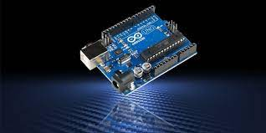
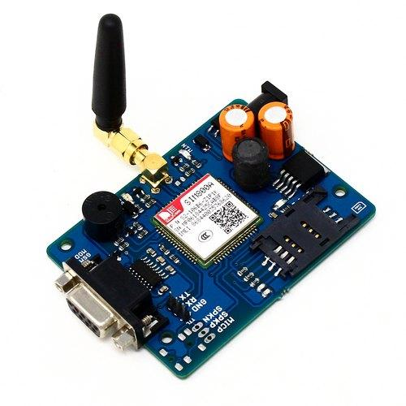
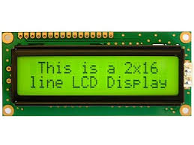
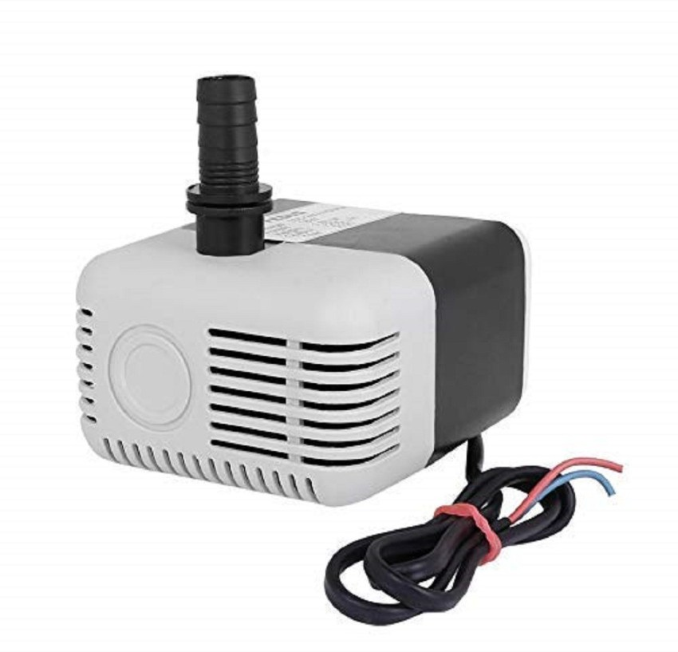

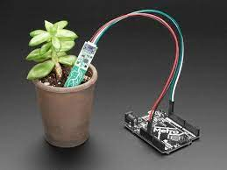
AUTOMATED IRRIGATION SYSTEM BASED ON SOIL MOISTURE USING IOT

Slide 2
TABLE OF CONTENTS
01
02
ABOUT US
INTRODUCTION
03
04
ABSTRACT
EXISTING SYSTEM

Slide 3
TABLE OF CONTENTS
05
06
PROPOSED SYSTEM
SOFTWARE AND HARDWARE REQUIREMENTS
07
08
LITERATURE SURVEY
MODULES

Slide 4
TABLE OF CONTENTS
09
10
RECOMMENDATIONS
CONCLUSIONS

Slide 5
01
ABOUT US

Slide 6
PROJECT MEMBERS
K.Sai Kiran 19KB1A0579
K.Hema Tejasree 19KB1A0580
K.Niranjan 19KB1A0581
K.Lakshmamma 19KB1A0583
UNDER ESTEEMED GUIDANCE
OF
K.RAVEENDRA CHAITHANYA B.TECH,M.TECH,(PH.D)

Slide 7
02
INTRODUCTION

Slide 8
INTRODUCTION
Agriculture is the unquestionably the largest livelihood provider in India. In order to support greater production in farms, the requirement of the amount of fresh water used in irrigation also rises.With the advent of open source Arduino boards along with cheap moisture sensors, it is viable to create devices that can monitor the soil moisture content and accordingly irrigating the fields or the landscape as an when needed. The proposed system makes use of microcontroller on arduino uno platform and IOT which enable farmers to remotely monitor the status of sprinklers installed on the farm by knowing the sensor values thereby, making the farmers' work much easier as they can concentrate on other farm activities.

Slide 9
03
ABSTRACT

Slide 10
ABSTRACT
The evolving information technology abridges the hardship in the daily life of consumers all over the world, hence the application of this knowledge in the irrigation field is necessary nowadays. The exponential growth of demand in food is due to the ever-evolving population of the world, thus it becomes necessary to expand the present area of cultivation. Considering the present situation of weather change due to global warming because of industrial activities, farming via irrigation is the reliable process of food production. Water remains the only source for survival for crop production, thus optimal management and proper use of water become pertinent with the ever-increasing land for irrigation. Arduino based automatic plant irrigation control system; provides a simple approach to automated irrigation. This work makes use of the GSM module for the notification of the user about the situation in the farm, this project aims to design and implement an automatic plant irrigation control system using Arduino and GSM module.

Slide 11
04
EXISTING SYSTEM

Slide 12
EXISTING SYSTEM
In existing systems , there are DTMF BASED CONTROL in the system we have to control motor through phone without knowing the soil moisture status . And also no Automation.

Slide 13
05
PROPOSED SYSTEM

Slide 14
PROPOSED SYSTEM
In this project , the automated irrigation system based on low power microcontroller was developed and deployed.
In proposed system, we are using ARDUINO UNO , moisture sensor , LCD, Relay and water motor.
The required electrical and electronic components of this proposed system are moisture sensor and water motor.
Moisture sensor detects the humidity level in the soil, if humidity is low the water motor will be ON.
The status of sensor will be displayed on LCD and water motor will be controlled through the status of soil moisture sensor.

Slide 15
06
SOFTWARE AND HARDWARE REQUIREMENTS

Slide 16
SOFTWARE REQUIREMENTS
ARDUINO IDE
C LANGUAGE

Slide 17
HARDWARE REQUIREMENTS
Power supply
Micro Controller
Soil moisture sensor
LCD
Water motor

Slide 18
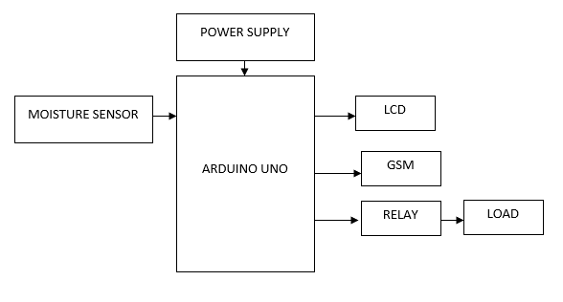
ARCHITECTURE OF THE PROJECT

Slide 19
07
LITERATURE SURVEY

Slide 20
LITERATURE SURVEY
In A Remote Measurement and Control System for Greenhouse Based on GSM-SMS the proposed system introduced a GSM-SMS remote measurement and control system for greenhouse based on PC-based database system connected with base station. Base station is developed by using a microcontroller, GSM module, sensors and actuators. In practical operation, the central station receives and sends messages through GSM module. Criterion value of parameters to be measured in every base station is set by central station, and then in base stations parameters including the air temperature, the air humidity. Indu et al. (2013) mainly focuses on reviews in the field of remote monitoring and control, the technology used and their potential advantages. The paper proposes an innovative GSM/Bluetooth based remote controlled embedded system for irrigation. The system sets the irrigation time depending on the temperature and humidity reading from sensors and type of crop and can automatically irrigate the field when unattended. Information is exchanged between far end and designed system via SMS on GSM network. A Bluetooth module is also interfaced with the main microcontroller chip which eliminates the SMS charges when the user is within the limited range of few meters to the designated system.

Slide 21
LITERATURE SURVEY
The system informs users about many conditions like status of electricity, dry running motor, increased temperature, water content in soil and smoke via SMS on GSM network or by Bluetooth. In R.Suresh et al. (2014) mentioned about using automatic microcontroller based rain gun irrigation system in which the irrigation will take place only when there will be intense requirement of water that save a large quantity of water. These systems bring a change to management of field resource where they developed a software stack called Android is used for devices that include an operating system, middleware and key applications. The Android SDK provides the tools and APIs necessary to begin developing applications on the Android platform using the Java programming language. Mobile phones have almost become an integral part of us serving multiple needs of humans. This application makes use of the GPRS feature of mobile phone as a solution for irrigation control system. These system covered lower range of agriculture land and not economically affordable.

Slide 22
08
MODULES

Slide 23
MODULE 1: GSM MODULE
This is a GSM/GPRS-compatible Quad-band cell phone, which works on a frequency of 850/900/1800/1900MHz and which can be used not only to access the Internet, but also for oral communication (provided that it is connected to a microphone and a small loud speaker) and for SMSs. Externally, it looks like a big package (0.94 inches x 0.94 inches x 0.12 inches) with L-shaped contacts on four sides so that they can be soldered both on the side and at the bottom. Internally, the module is managed by an AMR926EJ-S processor, which controls phone communication, data communication (through an integrated TCP/IP stack), and (through an UART and a TTL serial interface) the communication with the circuit interfaced with the cell phone itself . The processor is also in charge of a SIM card (3 or 1,8 V) which needs to be attached to the outer wall of the module. In addition, the GSM900 device integrates an analog interface, an A/D converter, an RTC, an SPI bus, an I²C, and a PWM module. The radio section is GSM phase 2/2+ compatible and is either class 4 (2 W) at 850/ 900 MHz or class1(1W)at1800/1900MHz.

Slide 24
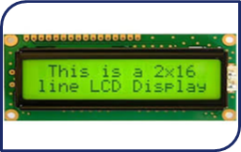
MODULE 2: ELECTRONIC DISPLAY MODULE
LCD (Liquid Crystal Display) is a type of flat panel display which uses liquid crystals in its primary form of operation. LEDs have a large and varying set of use cases for consumers and businesses, as they can be commonly found in smartphones, televisions, computer monitors and instrument panels. They work by using liquid crystals to produce an image. The liquid crystals are embedded into the display screen, and there's some form of backlight used to illuminate them. The actual liquid crystal display is made of several layers, including a polarized filter and electrodes.

Slide 25
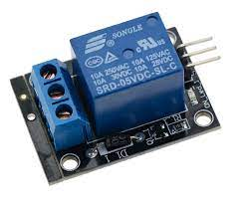
MODULE 3: RELAY MODULE
A relay is an electrical switch that opens and closes under the control of another electrical circuit. In the original form, the switch is operated by an electromagnet to open or close one or many sets of contacts. A relay is able to control an output circuit of higher power than the input circuit, it can be considered to be, in a broad sense, a form of an electrical amplifier. Relays are usuallly SPDT (single pole double through switch)or DPDT (double pole double through switch) but they can have many more sets of switch contacts, for example relays with 4 sets of changeover contacts are readily available.

Slide 26
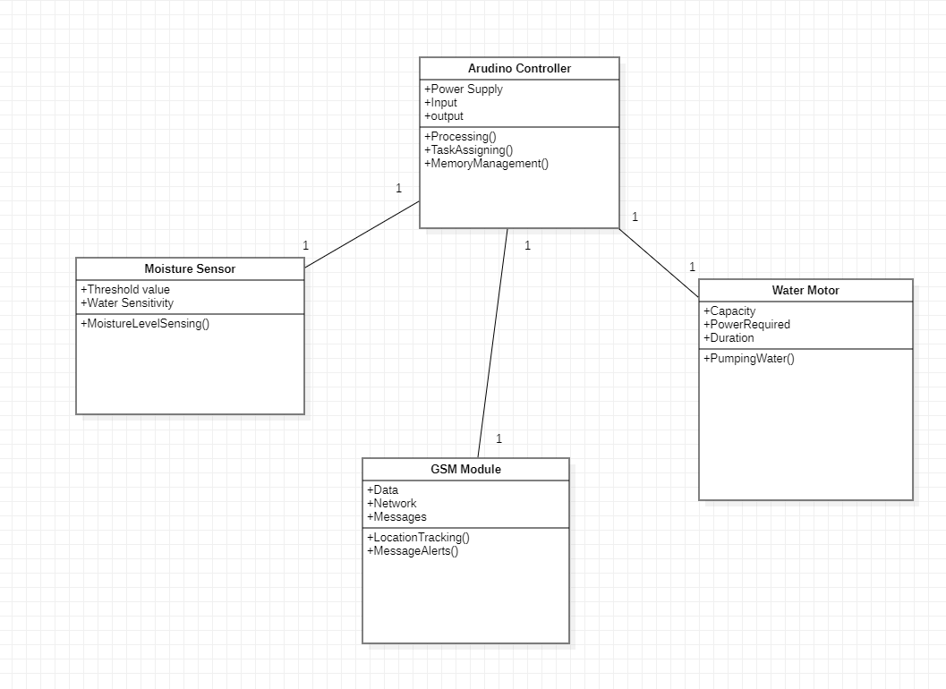
CLASS DIAGRAM

Slide 27
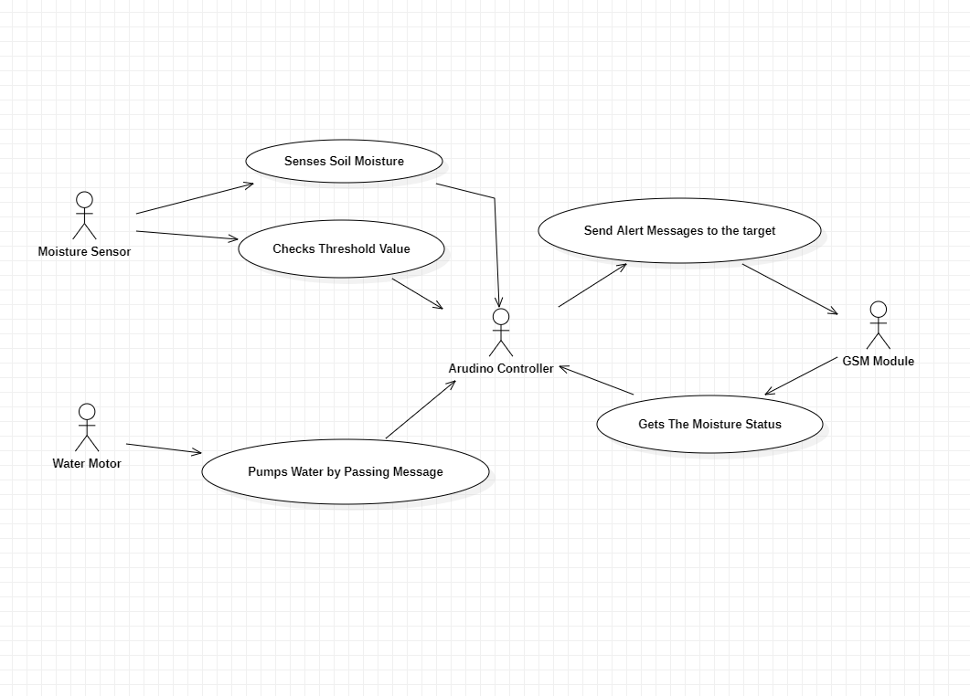
USECASE DIAGRAM

Slide 28
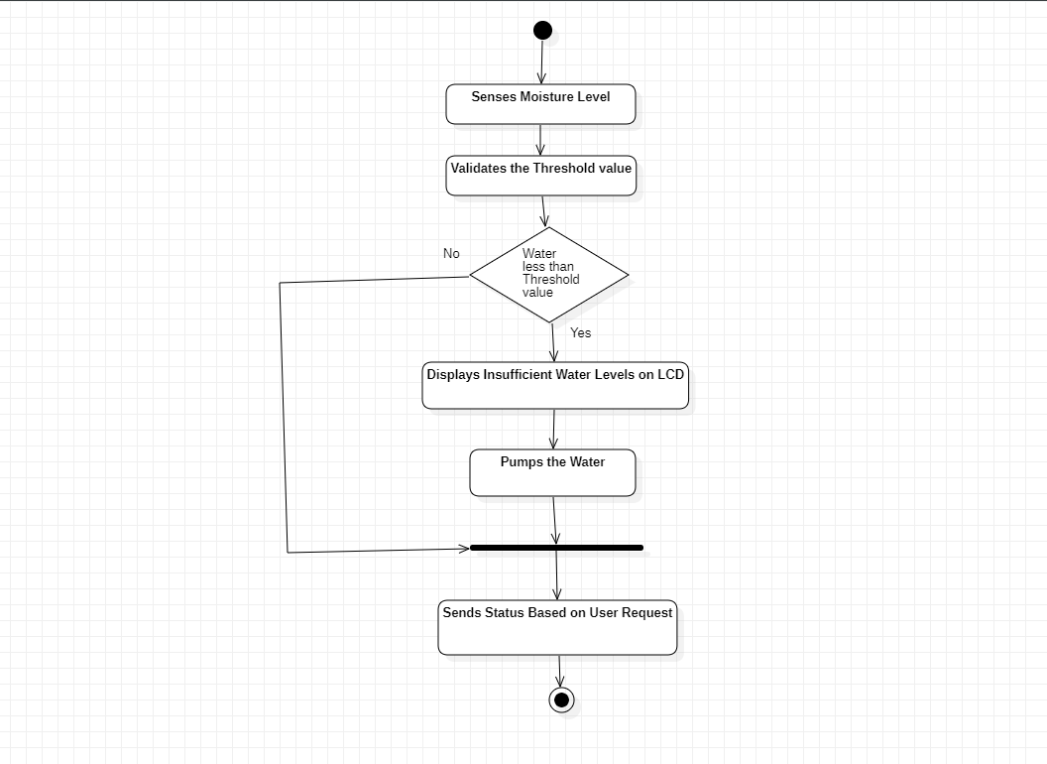
ACTIVITY DIAGRAM

Slide 29
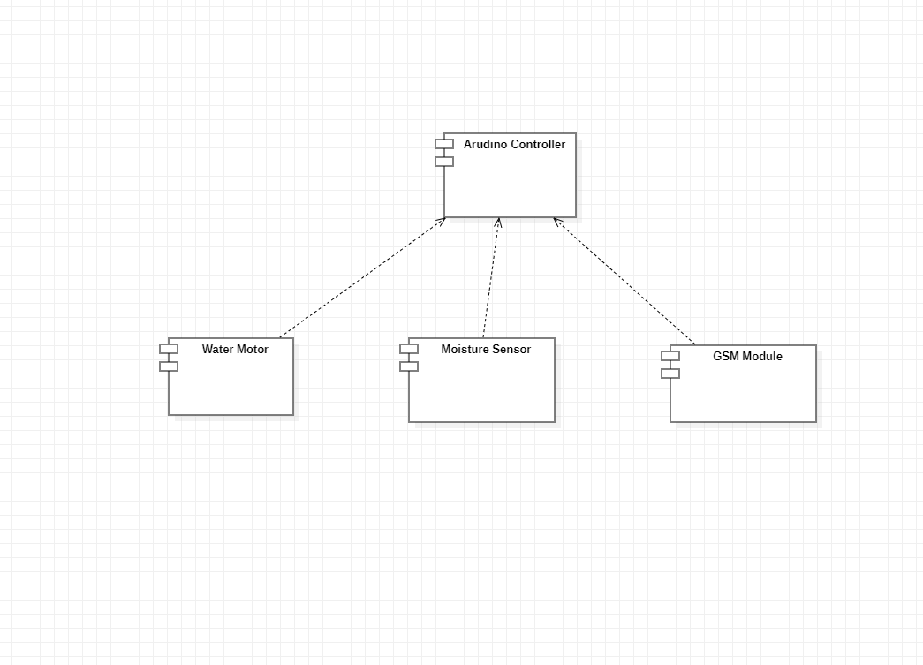
COMPONENT DIAGRAM

Slide 30
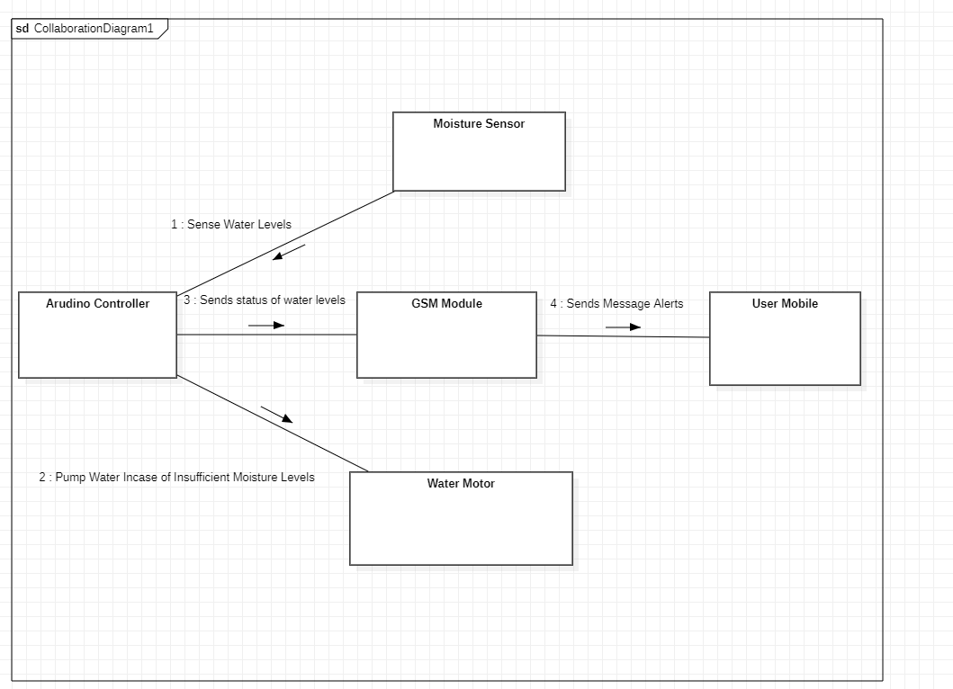
COLLABORATION DIAGRAM

Slide 31
09
RECOMMENDATIONS

Slide 32
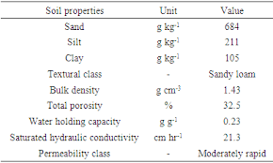
RECOMMENDATIONS
Table of different types of soils and water level requirements.
Suggested to portrait a table on different crops and water level requirements.
Usage on the real world practice

Slide 33
10
CONCLUSION

Slide 34
CONCLUSION AND FURTHER SCOPE
An automatic plant irrigation system using Arduino is designed in this project. The prototype of the model worked properly when tested on different soils. The components that we use in the system are readily available and easy to operate. Thus, this system acts as an effectual method of irrigation. It is far better than the manual irrigation process which requires a lot of manpower and time. By using the app, the farmer can operate the system from distant places. The farmer can utilize this time in other significant activities. Also, the major issue of water scarcity is dealt with. No amount of water is wasted in the process of irrigation. Thus, this system can be very useful in areas where water is in short supply.Farmers can thus benefit from the enhanced crop yields.
FURTHER SCOPE: The future work of the system can include the addition of temperature sensors and a more powerful motor to pump water to the fields. Thus, the large-scale implementation of the project can also be done.

